Slide 1

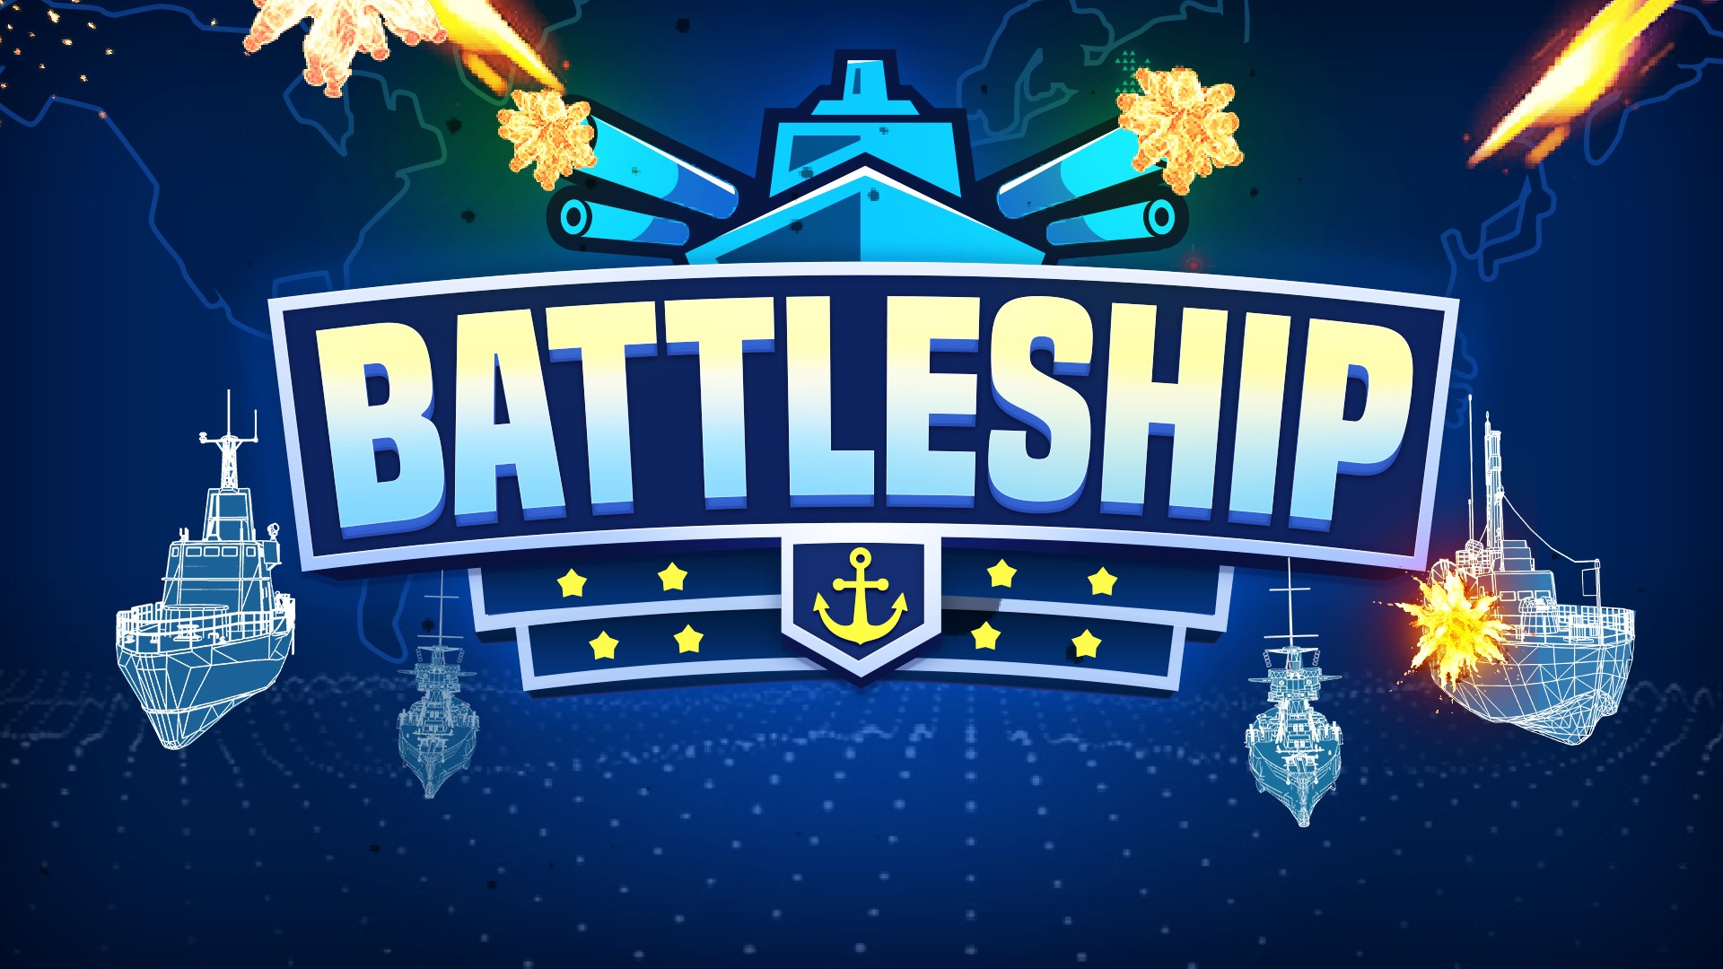

Slide 2



MEMBERS
LÊ NHẬT TRƯỜNG
ITITIU18157
NGUYỄN HOÀNG LONG
ITITIU18257
NGUYỄN NGUYÊN HƯNG
ITITIU18182

Slide 3

Table of Contents
Introduction
Game Setup
Data Structures
Algorithms
Design Patterns
Demo Gameplay

Slide 4

Introduction
Battleship is a strategy type guessing game for two players. It is played on ruled grids on which each player’s fleet of ships are marked. The locations of the fleets are concealed from the other player.
Players alternate turns calling “shots” at the other player’s ships, and the objective of the game is to destroy the opposing player’s fleet.
After each shot, the player is informed if the shot has been a “hit” or a “miss”, but no other information is given. In the original version the shapes of the ships are line segments of different lengths.

Slide 5
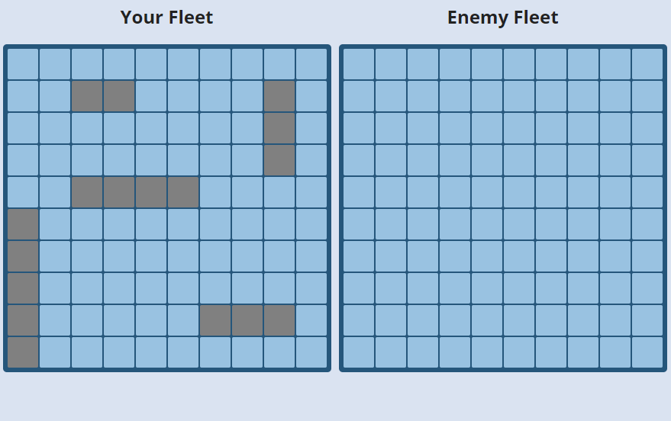
GAME RULES
The ships are in ascending size order:
Patrol Boat (2x1)
Submarine (3x1)
Destroyer (3x1)
Battleship (4x1)
Aircraft Carrier (5x1)
Notes:
Each player draws their ships on their fleet grid .
The ships can be positioned anywhere on the grid but must go horizontally or vertically, never on a diagonal, and none must overlap.
Players also each have a tracking grid on which to mark their shots.

Slide 6
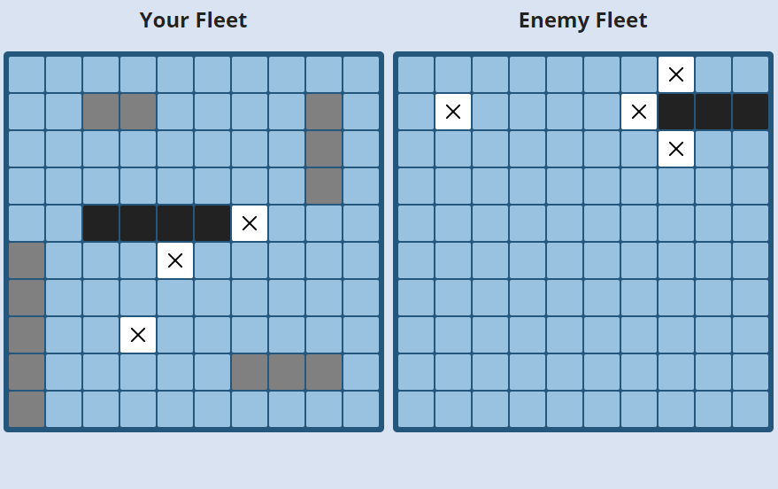
GAME RULES
Players then take turns to fire at their opponent’s ships.
Their opponent must show whether the shot has found a target and mark the shot on their fleet grid.
When every square of a ship has been hit, the player announces that it has been sunk.
Notes:
Players then take turns to fire at their opponent’s ships. In each round the attacker identifies the square they are aiming at, marking the shot on their tracking grid.
Their opponent must show whether the shot has found a target and mark the shot on their fleet grid. On both grids, hits are recorded with red squares and letter X and
misses with white square and letter X.
When every square of a ship has been hit, the player announces that it has been sunk and it’s also recorded with black square.
The game’s winner is the first person to sink all their opponent’s ships.

Slide 7

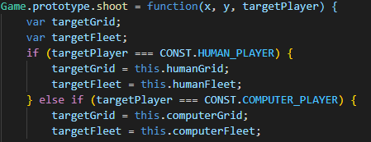
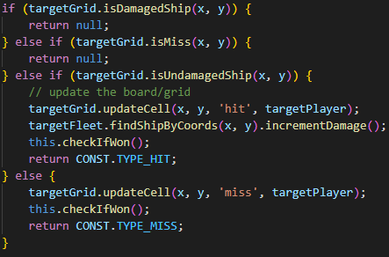
GAME SETUP
Notes:
First, we create a variable of game board size, 10x10.
Next, we create the shoot function that get x, y and the target of enemy position.
Check that if that position is a damaged ship or miss will return null.
And if that target position is undamaged ship, it will update the board and the grid.

Slide 8
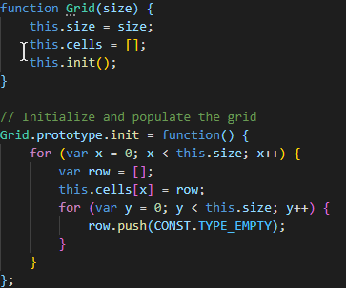
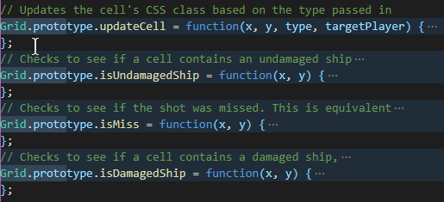
GAME SETUP
Notes:
First, we create a grid 10x10
And in the for loop, we set values of all cells are type_empty= 0,
because the grid is empty in initial
And we know that the values of each cell will be change in game processing.
So, we create the function to update the cells.
we will have two types of grid, that are the grid of HUMAN_PLAYER and the grid of COMPUTER_PLAYER.
in the update cell function, having a switch case instruction,
to list all values of cells can be occurred such as: type_Empty, type_SHIP, type_MISS, type_HIT, type_shunk
And in game processing,
we need function to check what is type of cell contain, before we update the cell of grid

Slide 9
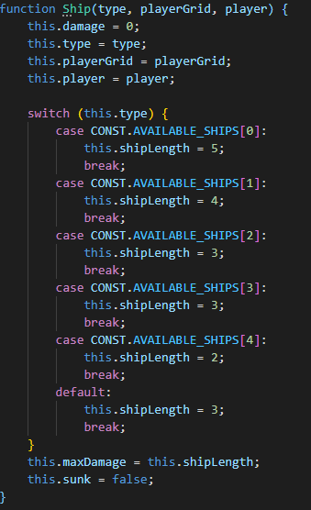
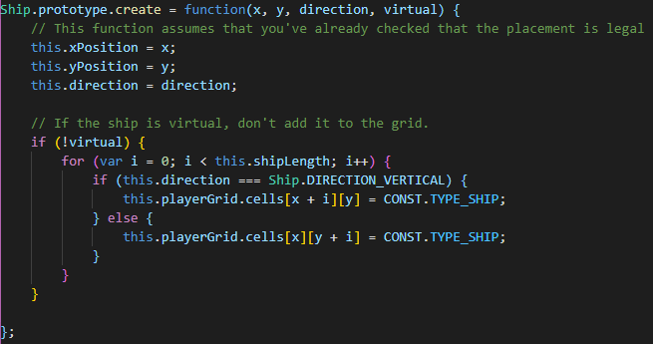
GAME SETUP
Notes:
we create 4 types ship are 'carrier', 'battleship', 'destroyer', 'submarine', 'patrol boat' then store it in 1 array
each ship must have type to show type of ship,
depend on the type of each ship we set length for them by switch case instruction,
and parameter playerGrid, player to present that this ship is owned by Al or human
and the damage show that the ship was destroyed or not.
each ship must have their coordinates(x, y) and direction(vertical or horizontal)
If the ship is declared "virtual", then the ship gets initialized with
its coordinates but DOESN'T get placed on the grid.

Slide 10
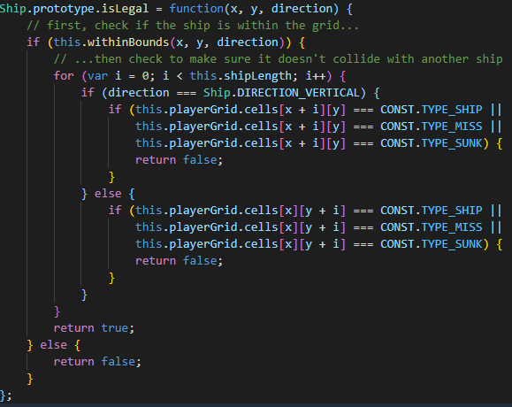
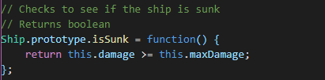
GAME SETUP
Notes:
and to place the ship to the grid we must have a function to check the location of ship is legal or not
first, we check the ship is within the grid or not,
then check to make sure it doesn't collide with another ship
The function isSunk check the state of ship is sunk completely or not

Slide 11
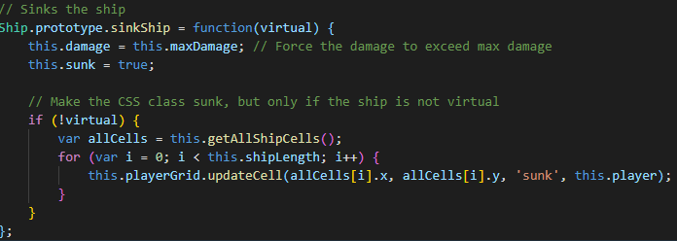
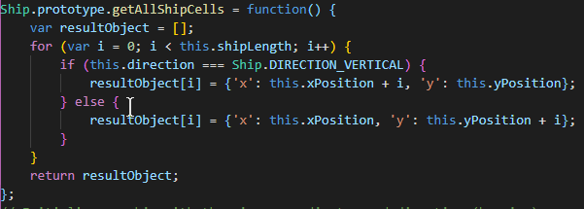
GAME SETUP
Notes:
Then, we create a 2 more function for the ship
first function is sinkShip to update the state of ship on grid
The second function is getAllShipcells to get the position of the ship.

Slide 12
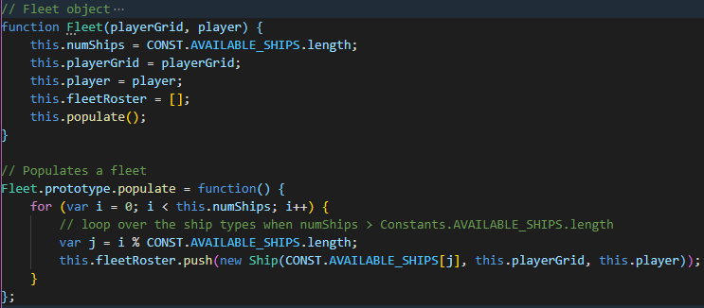
GAME SETUP
Notes:
Now, we come to the fleet object,
we use a for loop to populates a fleet of ships was selected to fleetRoster array

Slide 13
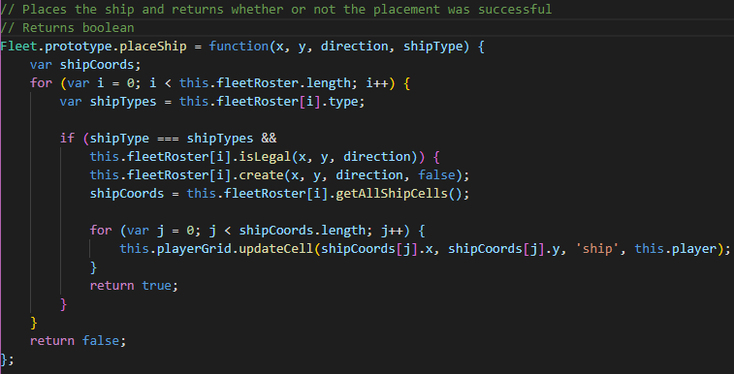
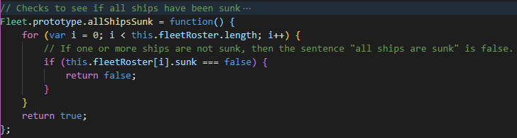
GAME SETUP
Notes:
next, we come to the part that how to place ship on the grid.
to place the ship on the grid you must know their coordinates(x, y), their direction and type of ships
after check the legal of ships location we can create a ship and place it to the grid.
Then to find out the winner, we create a function allShipsSunk to check all ship sunk or not.

Slide 14
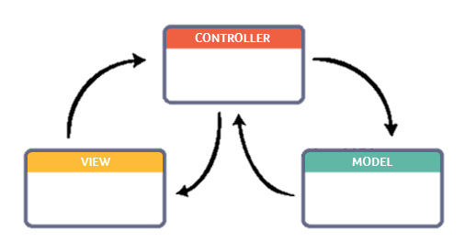
MODEL – VIEW - CONTROL
Notes:
Another perspective on designing software that requires user interaction, is the concept (or design pattern) of Model-View-Controller (MVC),
which separates the tasks of the different components of the software in a way such that three general roles can be singled out: The model, the View and the Controller.
The benefit of using the MVC design pattern is separation of data (the Model) and the View and Controller.
This separation makes it easy to update the implementation of the Model, for instance, since the Model and its underlying data structures are independent of the View and the Controller.

Slide 15







MODEL
The Model contains the basic, underlying data access methods and data storage.
This part is a connection between two components, View and Controller.
When model changes, it notifies the view.

Slide 16

VIEW
View is the means of displaying objects in an application. It includes anything that is visible to the user.
Views that offer access into the model. These should be well implemented and function perfectly.
The view knows how to draw model and calls controller as reaction on user input.

Slide 17
Controller
Controller is the part of the software that listens for user input and reacts accordingly.
When Views require information to draw the UI, the Controller should query the model for that information when requested to do so.
When validating if the launch missile action is allowed, the model should respond to the controller by returning information from a “launch missile” method call.
Notes:
When the user taps a grid cell, the Controller should ask the model to perform the “launch missile” action (using a delegation pattern or target-action mechanism), rather than the view doing this.

Slide 18

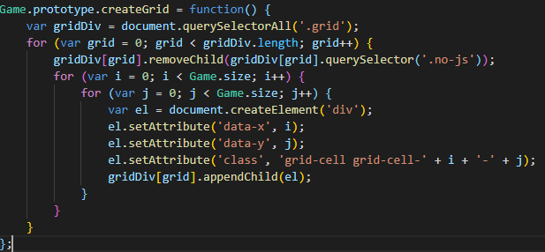
Data Structures
Two – Dimensional Array
Each element can be accessed simply by using the x and y coordinates of the game board as array index.
Notes:
For the Data Structures, we implement a two-dimensional array, where each array index points to an integer that represents a certain field and its status. A field can have a ship on it or be empty, and it can at the same time be hit or not hit. The two-dimensional array is very easy to use, and each element can be accessed simply by using the x and y coordinates of the game board as array index.
The efficiency of this two-dimensional array data structure is very good. It takes constant time to lookup any element, independent of the number of elements stored in the array.

Slide 19
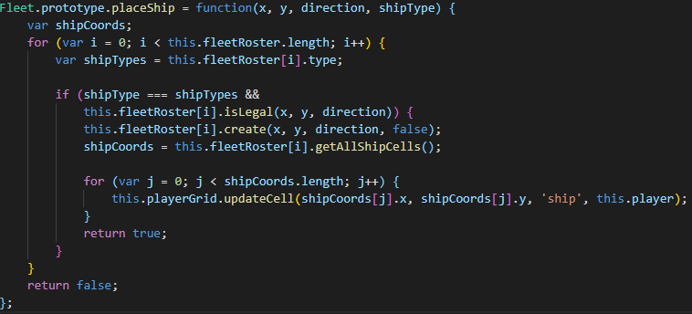
Data Structures
Array List for storing the ships (The Fleet)
Central data structure for finding ships, when these are hit or sunk.
Notes:
We need some way of identifying the ship that could potentially lie on a board field. For this purpose, we developed the concept of a fleet. But since the game specification does not require us to allow for a random number of ships so we use an array list for storing the ships associated to the game board, data structure for finding ships, when these are hit or sunk.

Slide 20
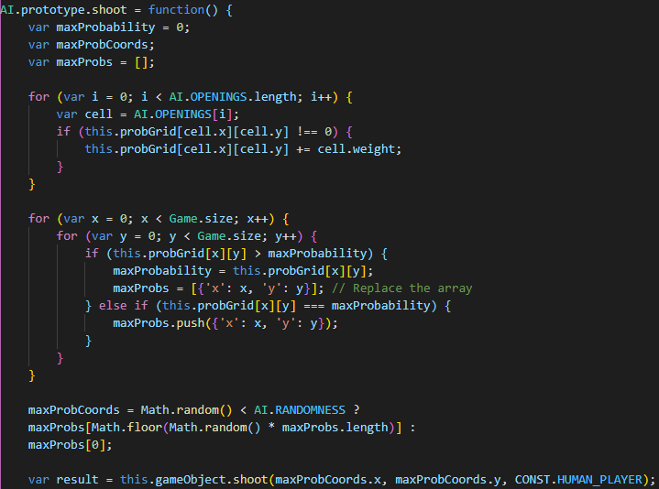
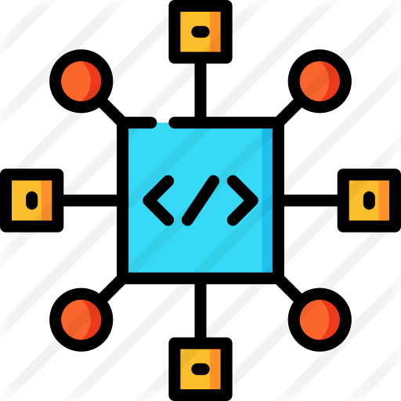
Algorithms
Notes:
For the first shot, the bot will choose randomly position of human-player ships.
When a shot is fired and a ship is hit for the first time, that there must be more parts of that ship on at least one of the neighboring game board fields, depending on the number and type of ships left on the game board.

Slide 21
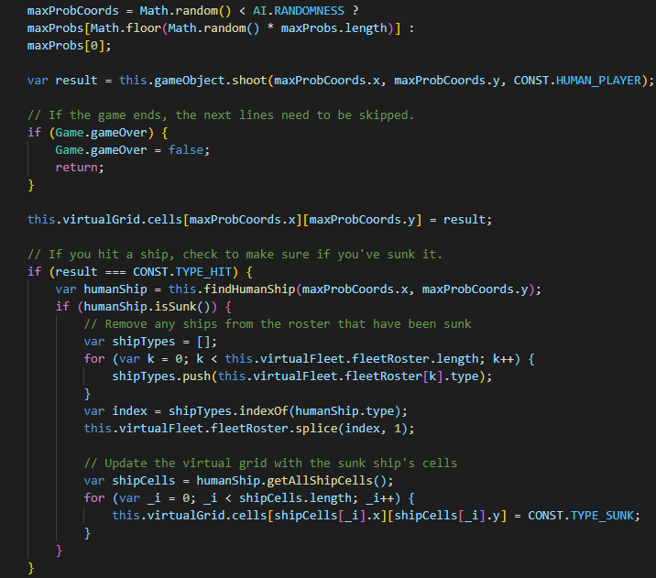
Algorithms
Notes:
After a successful first shot the machine player, the bot will try each of the direct neighbors to the field. When another shot becomes successful, the bot should then be able to knows the orientation of the ship it is firing at.
If two shots are successful, and they are oriented horizontally, the bot should not fire shots to either the above or below of the previously hit fields, but only to the right and/or left of the previously hit fields.

Slide 22
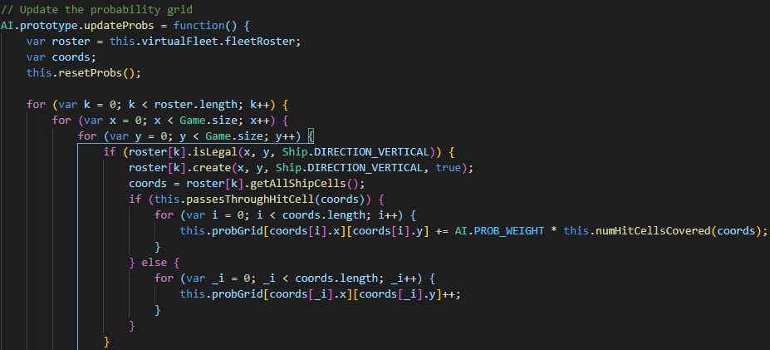
Algorithms
Notes:
So, after having had a second successful shot on one of the neighboring game board fields, the bot should continue firing in the direction suggested by the successful second shot.

Slide 23
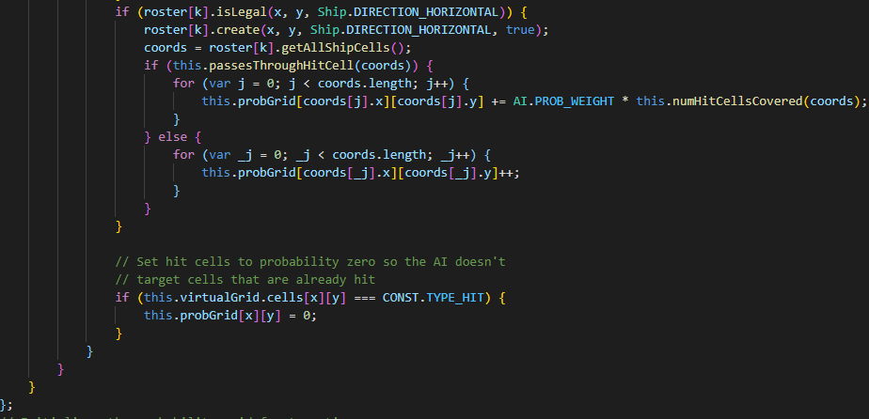
Algorithms
Notes:
The bot should then continue placing shots in this direction, until the ship is sunk, or an unsuccessful shot occurs. If an unsuccessful shot occurs, and the ship is still not sunk, the bot should continue firing in the opposite direction from where the first successful shot occurred, until the ship is sunk.

Slide 24
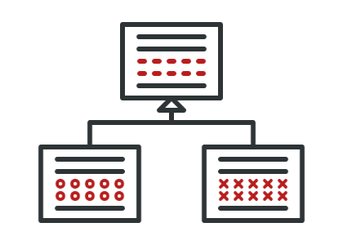
Design Patterns
Template
Notes:
Every turn requires a series of steps, most of those steps are equal even if are executed by human-player or the bot. Some specific steps requires specific implementation due to their behavior. For example, shooting is a step that the bot executed based on one strategy, but the human-player executed via pressing one slot in the grid. The idea to implement this pattern is to set and control the steps related with the turn of shooting, make the steps common in one specific place and each player implements specific steps depend on its behavior.

Slide 25
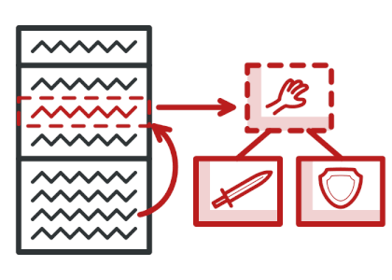
Design Patterns
Strategy
Notes:
The bot has to make an attack in the human-player board. It is possible to executed that attack in different ways: Randomly or Systematically. The first option is Randomly, so the bot create a shoot randomly and this shoot take the state of Successful or Missed. In the next turn of the bot, if the previous turn has the state of Successful, the bot change the strategy to Systematically in order to create the following shoots near the position of the previous shoot. So, we create possible shoots in Horizontal, Vertical direction. This change of behavior is carrying on runtime depending on the previous shoots executed by the bot.

Slide 26
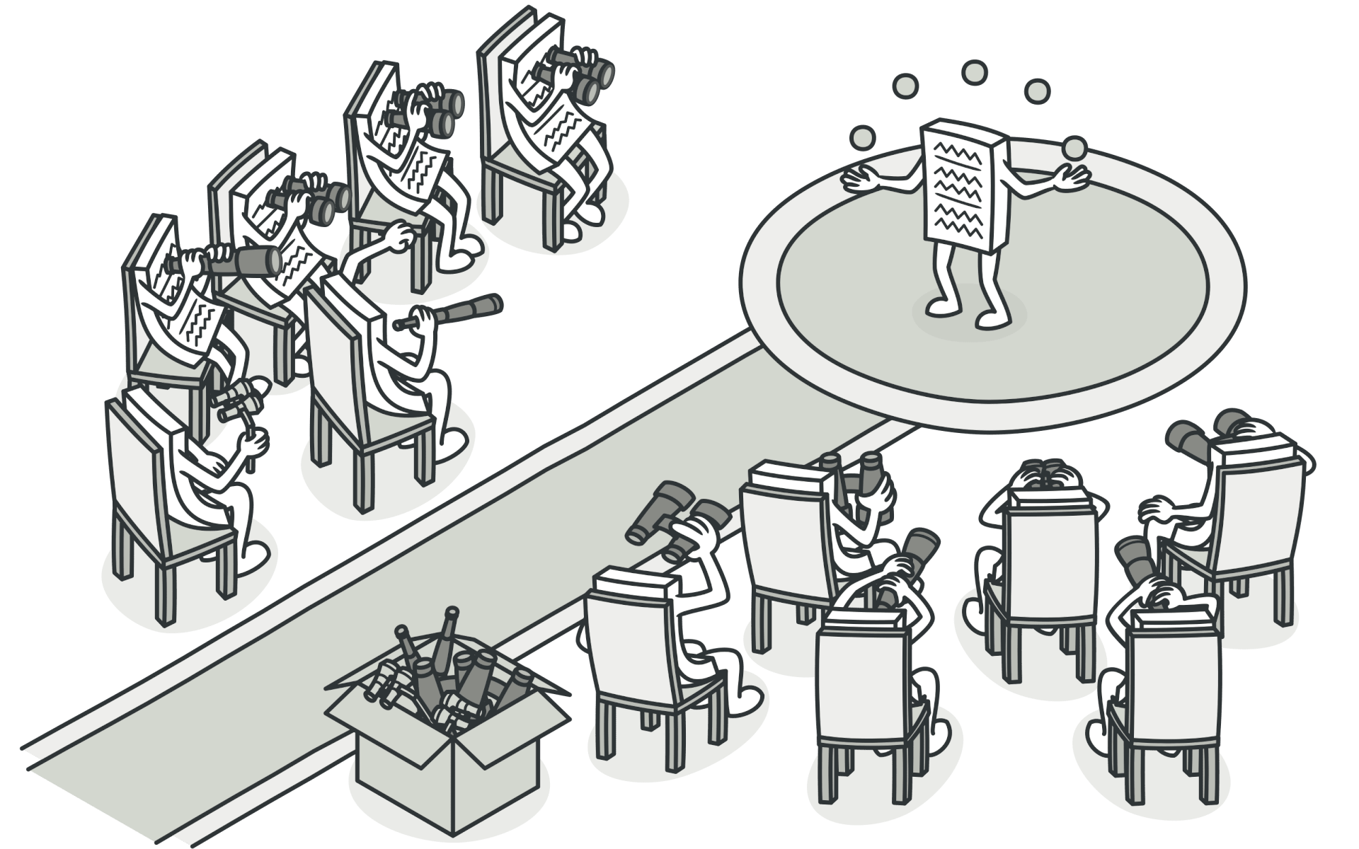
Design Patterns
Observer
Notes:
The Ship has basically state, Attacked and Destroyed. This State is updated with every shot that the ship received. When the State is updated in the Ship, the GUI have to update the information that display about the ship in order to inform to the player which kind of ship has been attacked and how many ships remain in the opponent board. The observer pattern is useful to update information in the GUI based on the different states of the Ships.

Slide 27
Thanks

